Slide 1
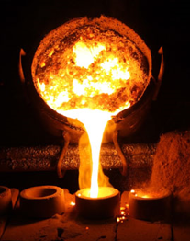


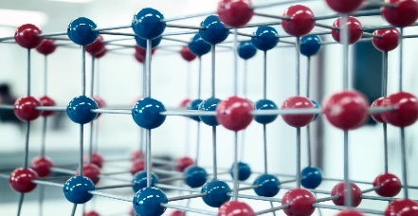
BTTD 2019
TECHNICAL PROGRAMME
Sept 5-6,2019
Inauguartion
09:30-11:00 Hrs.
Mechanical Behaviour, Welding & Failure Analysis
Session-I B / TP-12 to TP-22
Day 1, 11:15 – 13:45 Hrs
Material Processing & Alloy Development
Session-I A / TP-1 to TP-11
Day 1, 11:15 –13:45 Hrs
Lunch
13:45–14:30 Hrs.
Corrosion and Surface Engineering
Session-II A / TP-23 to TP-27
Day 1, 14:30 –16:40 Hrs
Metallurgy of Light Weight
Non-Ferrous Alloys
Session-II B / TP-28 to TP 32
Day 1, 14:30 –16:40 Hrs
BTTD
2019
NML Lecture Hall
CSIR NML D J Hall-1
Advanced Materials & Techniques
Session-III A / TP-33 to TP-42
Day 1, 16:00 – 18:00 Hrs
Tea Break
15:40–16:00 Hrs.
Extraction and Secondary Resource Utilization
Session-III B / TP-43 to TP-49
Day 1, 16:00 – 17:30 Hrs
e-Poster Presentations (EP 1 to EP 20)
Day 1, 05th July, 2019, Time 11:15 to 13:35 Hrs
Industrial Problem Solving
(IPS 2.0)
Day 2, 06th July, 2019, Time 14:30 to 16:30 Hrs
@ CSIR NML Auditorium Hall

